Slide 1



Trustless and simple ZKP

Slide 2
Sigma & Lelantus
Simple and Trustless ZKP

Slide 3

Why do you need blockchain privacy?
Do you want anyone to know?
What you bought before
Your potential networth
How much you earn and who you get it from
Do businesses want people to know
Who their suppliers are and how much they are paying them?
Who their customers are and how much they are buying?
The value and terms of their contracts?
For cryptocurrencies or blockchains to be used, privacy is a must!

Slide 4

What do you need for
a blockchain privacy system?
High anonymity that stands the test of time
Good performance that can scale
Small proof sizes (doesn’t occupy much space on the blockchain)
Quick verification times (nodes can check the validity quickly)
Low proof times + resources (the time it takes to create a private transaction)
Easy to use
Minimal trust required

Slide 5

Why do we need yet another privacy protocol?
No holy grail of privacy protocols: always trade offs
Privacy protocols that are ‘good enough’ today may not be good enough a few years down the line.
Are mixing or decoy transaction models enough?
RingCT
Coin mixers or tumblers (Cash Shuffle)
Mimblewimble

Slide 6
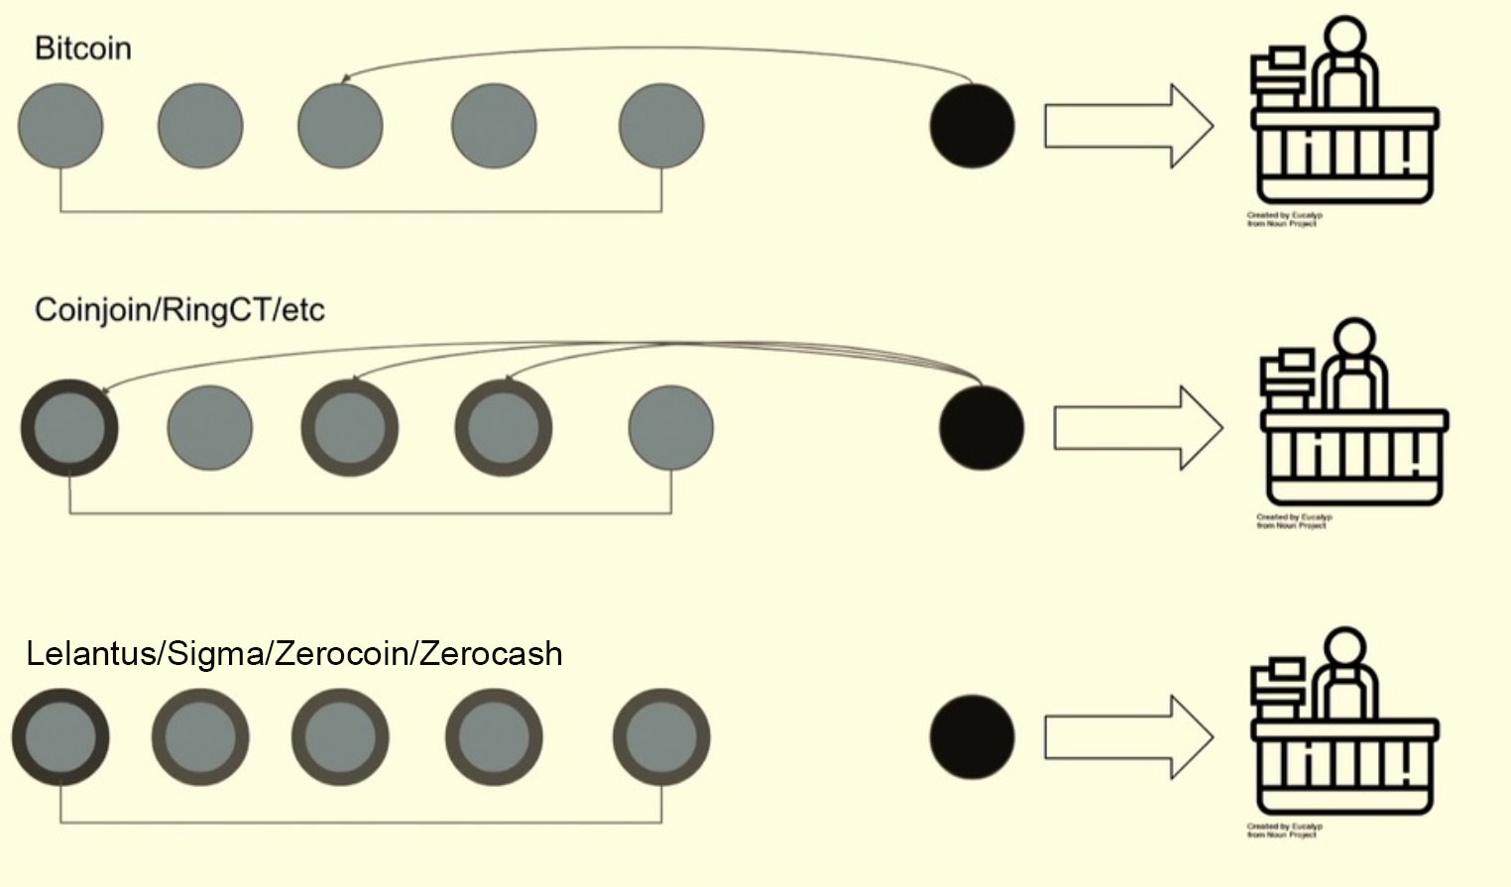
Decoy Systems vs ZKP

Slide 7
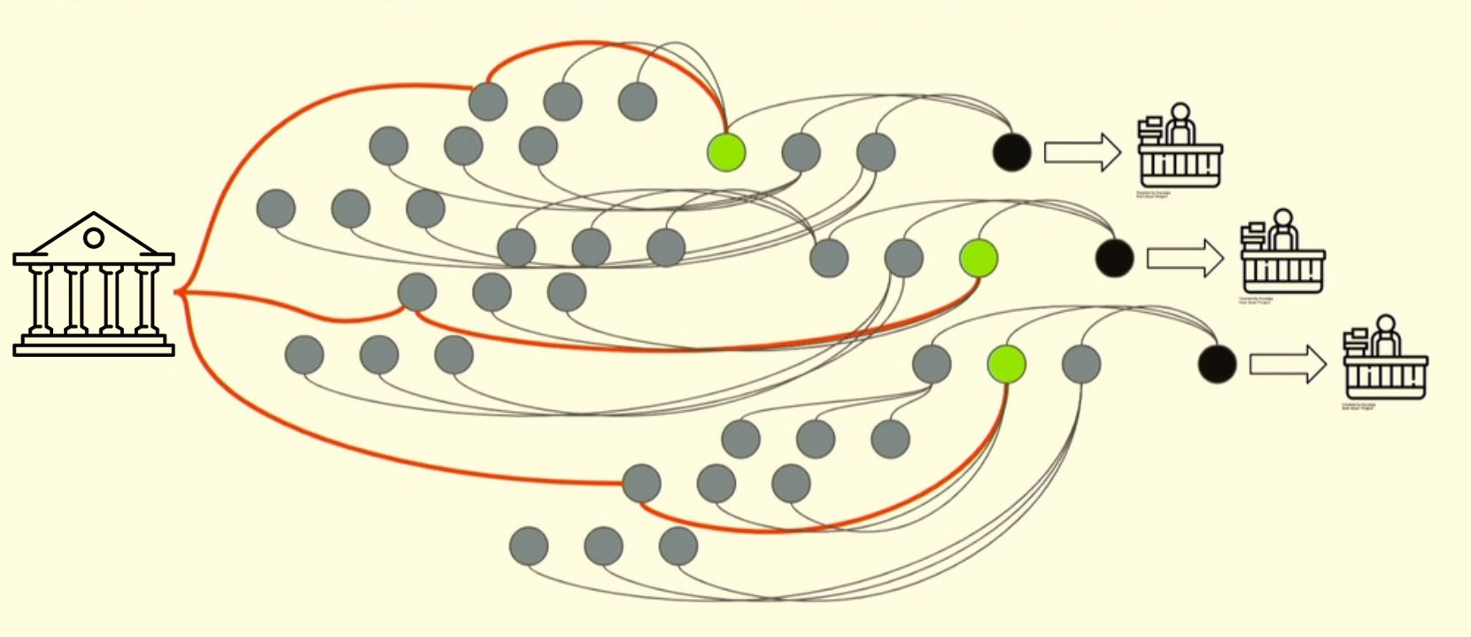
Decoy Systems vs ZKP

Slide 8
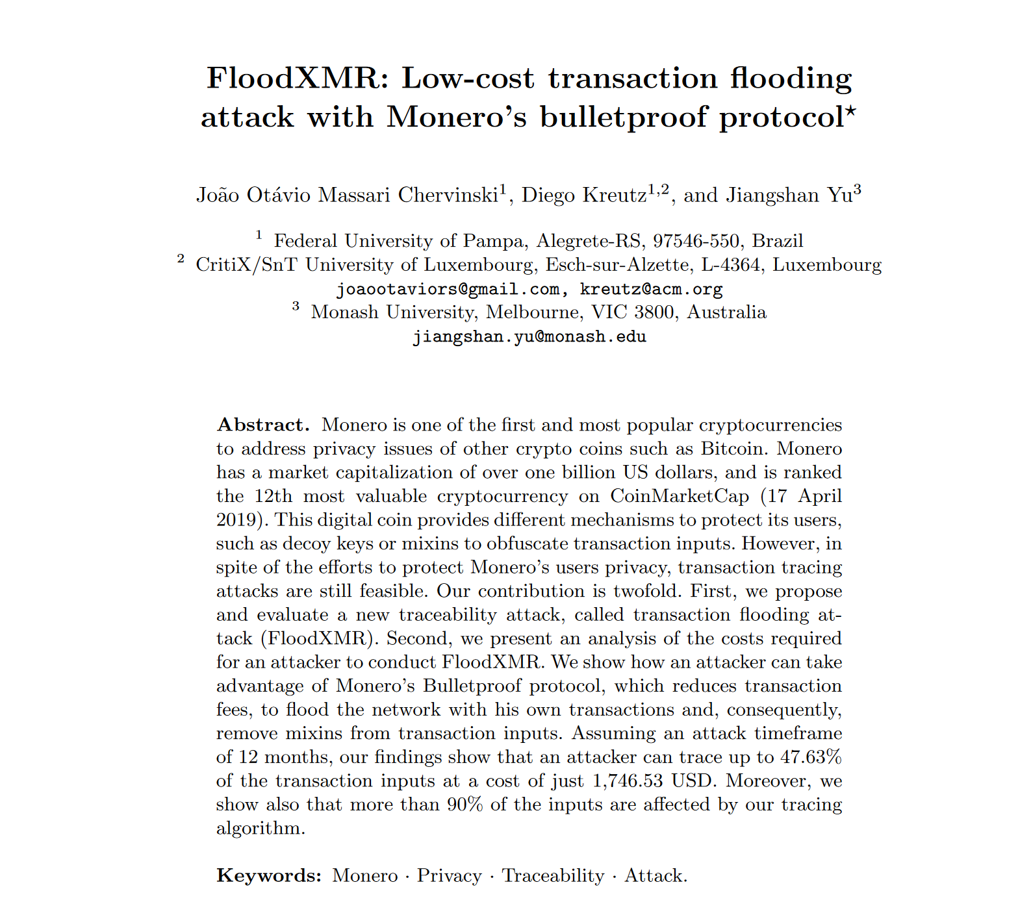
Decoy Systems vs ZKP
FloodXMR shows some weaknesses of decoy systems
Flooding with transaction spam to make others mix with you.
Cost is about 17,000 USD (figure disputed) a year or so to deanonymize ~50% of transactions. Cheap transactions actually hurt them by making it cheap to do an attack
How much is too expensive?

Slide 9
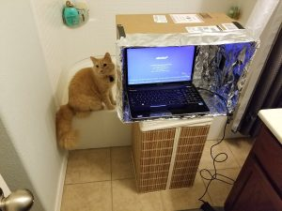
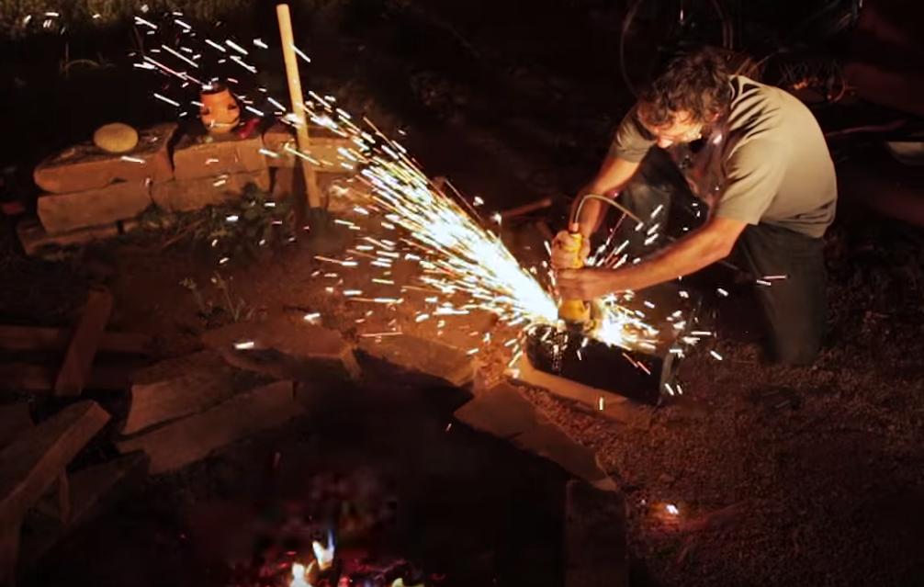
What about zkSNARKs?
Trusted setup is a problem with zkSNARKs
Against the idea of “Don’t trust, verify”
Mitigated by Sapling MPC
Extremely complicated cryptography and construction
Only a handful of cryptographers in the world understand it well
Often called moon math
Experimental cryptographic assumptions

Slide 10
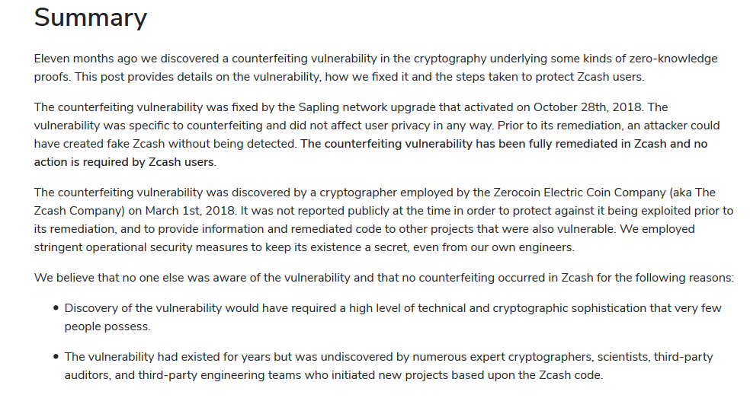
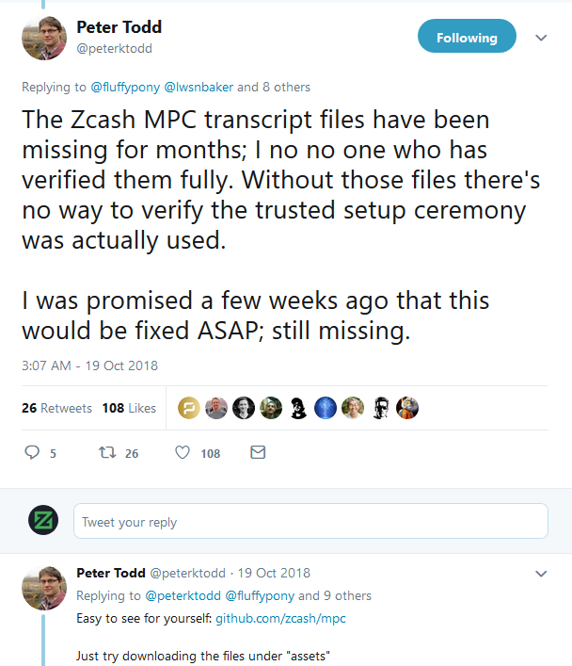

Slide 11
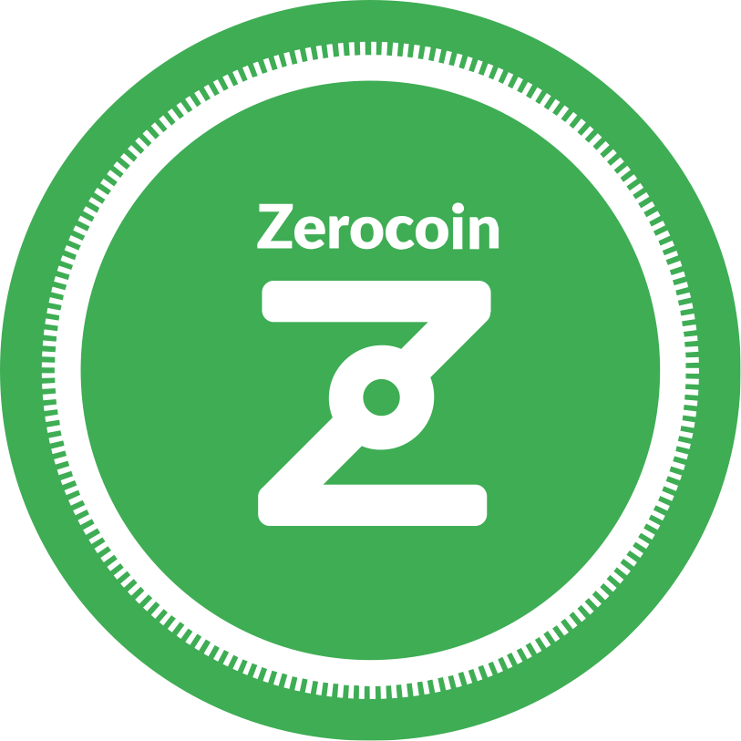
What about Zerocoin?
Very large proof sizes (25 kB and even reductions can only bring it to 10 kB)
Trusted setup still exists although done by third party (RSA Factoring Challenge held in 1991)
Long verification times (300-400ms) per spend transaction
Usage of fixed denominations
Susceptible to timing analysis
Inefficient since many spends are needed to fulfil arbitrary amounts
Variable anonymity set since it needs to be spread over each denomination.
Zcoin recently found a cryptographic flaw in one of its proofs allowing forgeries to be made. Although Zerocoin can be fixed, it is non trivial to do so.

Slide 12
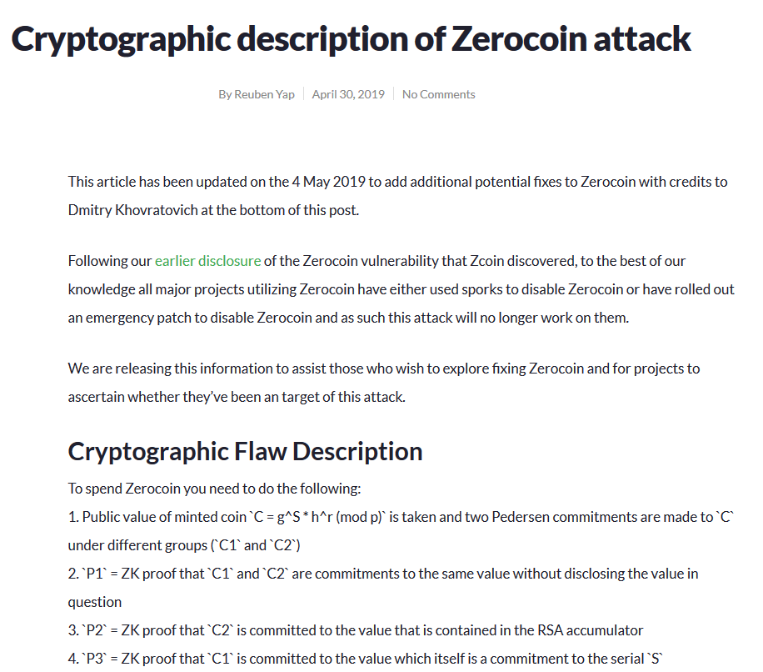

Slide 13
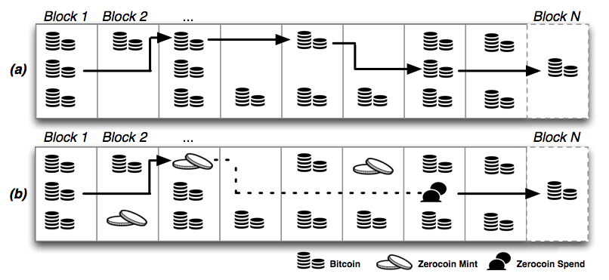
Mint Spend Repeat

Slide 14

What is Sigma?
Replaces the Zerocoin construction
Based on paper by Jens Groth and Markulf Kohlweiss called One-out-of-Many-Proofs Or How to Leak a Secret and Spend a Coin
Proof sizes for anonymity sets of 2^14 to 2^18 remain 2kB or less.
No trusted setup.
Simple cryptographic construction with full security proofs
Proofs can be batch verified:
Anonymity set 2^16 = 35 ms per proof
Anonymity set 2^18 = 180 ms per proof
Launched on Testnet!
Expect another month to mainnet.

Slide 15
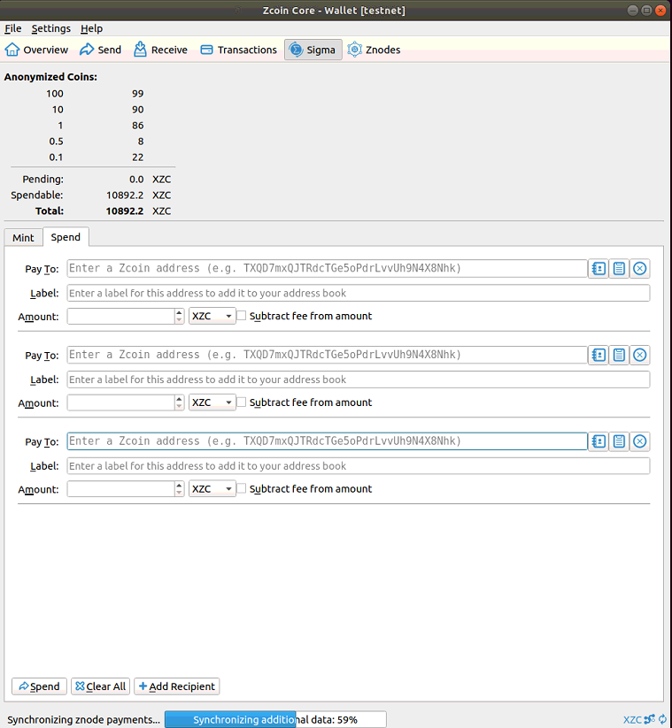
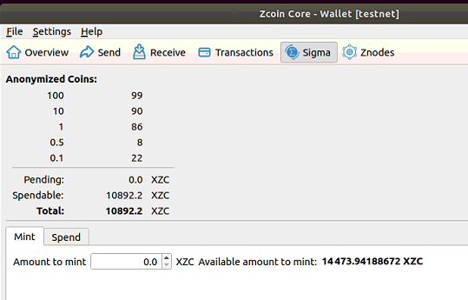
Sigma in Action

Slide 16
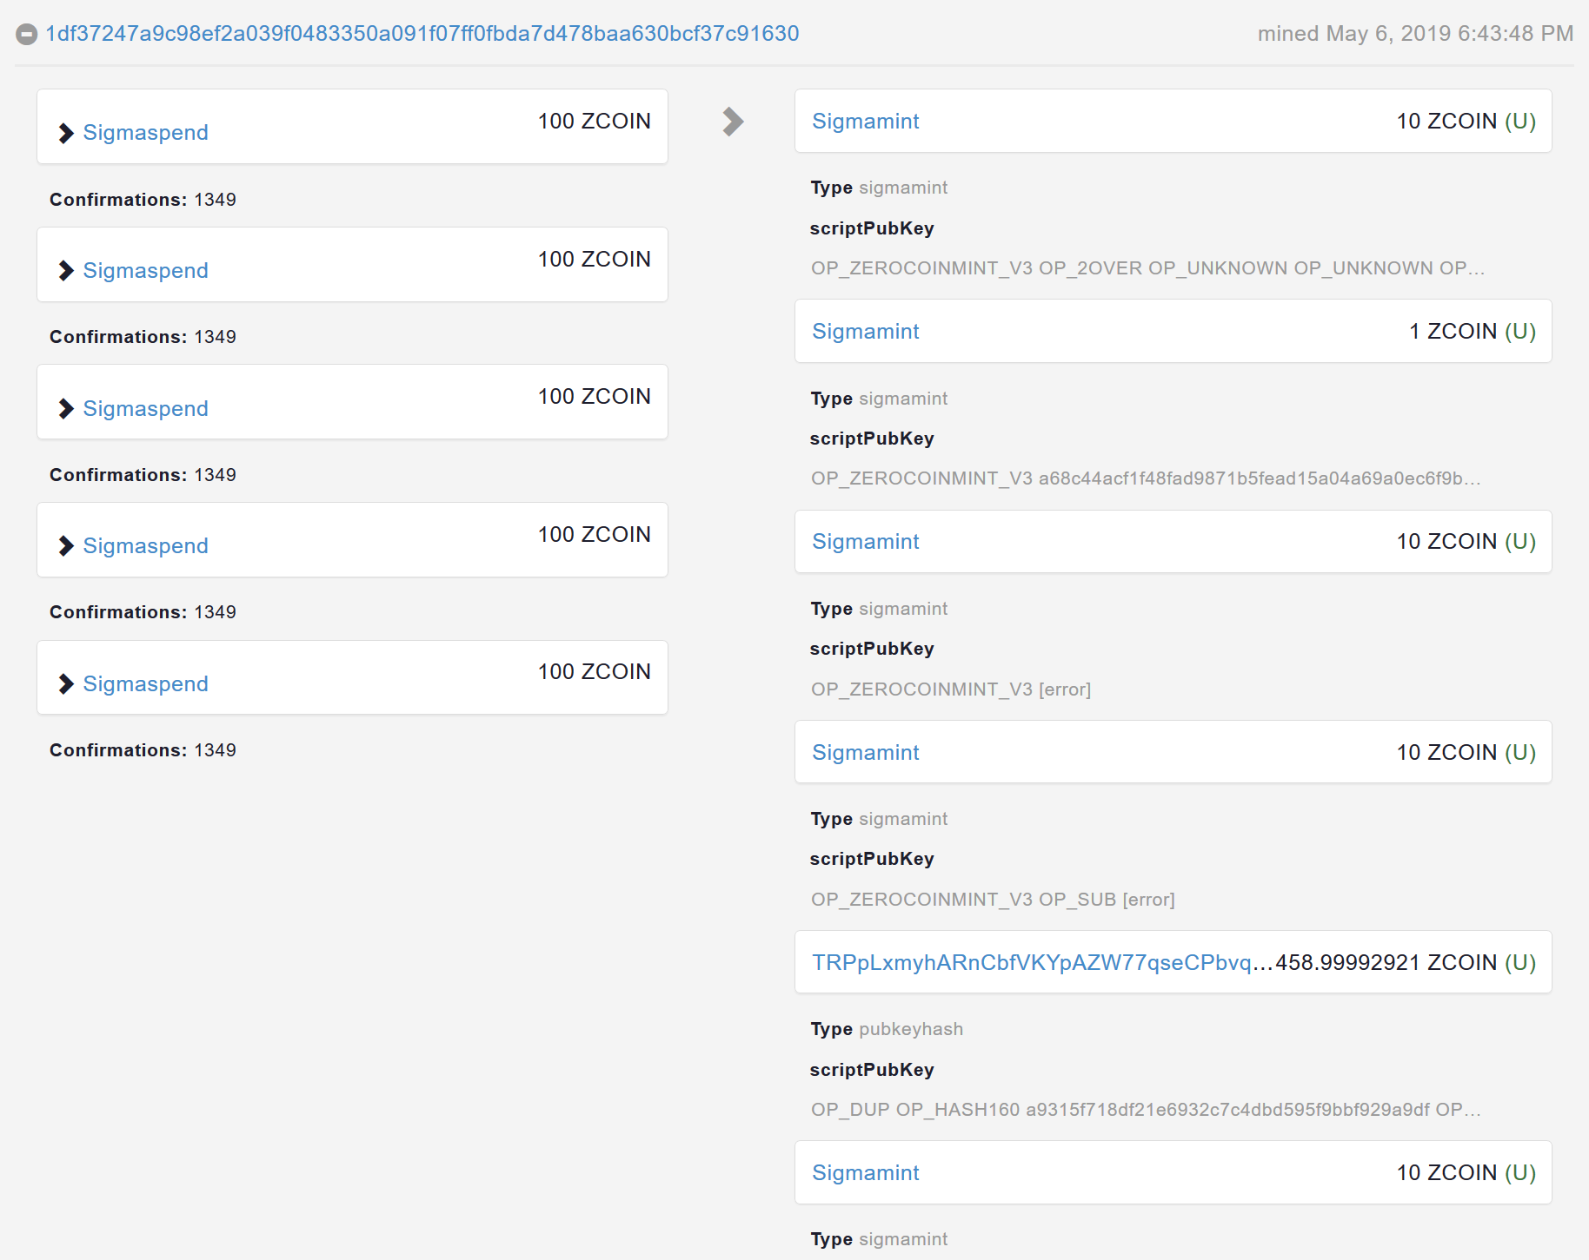
Sigma in Action

Slide 17
The problem with fixed denominations
Zerocoin and Sigma both use fixed denominations for e.g. 0.1, 0.5, 1, 10, 100
This is because redemption has to be IN FULL
If you have a ten dollar note, how do you spend 1.50 to someone else?
Redeem entire ten dollar note
Give 1.50 to third party
8.50 change comes back
What happens with 8.50 change? Mixes with other unclean funds that can deanonymize.
Anonymity set within each denomination.

Slide 18
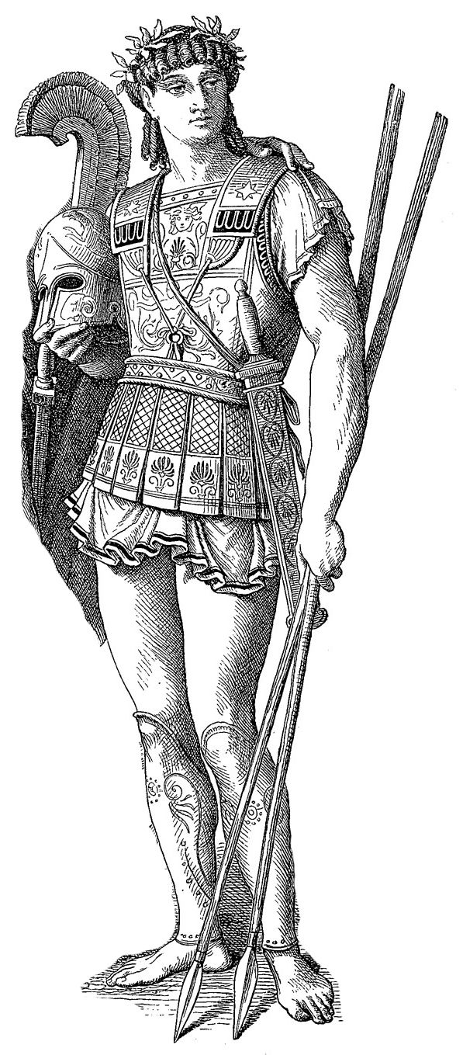
Lelantus
Lelantus builds on Zerocoin’s construction, One Out of Many Proofs and Bulletproofs.
Developed by Zcoin under cryptographer Aram Jivanyan
Operates on same principles of Zerocoin but some key differences
Doesn’t require trusted setup (uses One out of N proofs instead of RSA accumulators)
Small proof sizes (less than 2 kb)
Doesn’t require fixed denominations. Burn and spend any arbitrary amount.
Doesn’t require separate accumulators for each denomination, one global accumulator for all amounts.
Has ability to be extended to transfer coins while in burnt state
Uses DDH cryptographic assumptions
Aiming Q1 2019 release

Slide 19
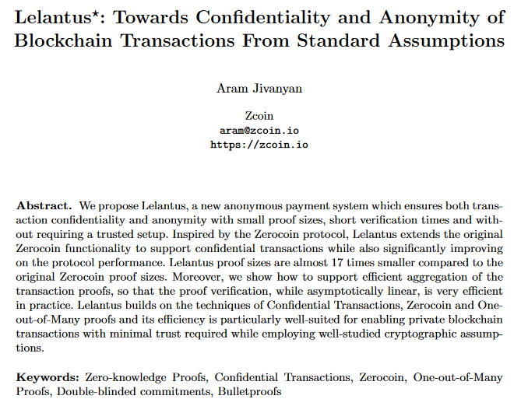
Lelantus
Cryptographic libraries complete and built entirely by Zcoin (working in private repo)
Undergoing peer review, much simpler construction makes it easier to audit
Prominent cryptographers have positive feedback on it Jens Groth (Dfinity), Sarang Noether (Monero), Ariel Gabizon (Zcash)
Proof of concept made by Sarang and available to public inspection
Still optimizing, Lelantus+ under development to reduce proof times
https://eprint.iacr.org/2019/373.pdf

Slide 20
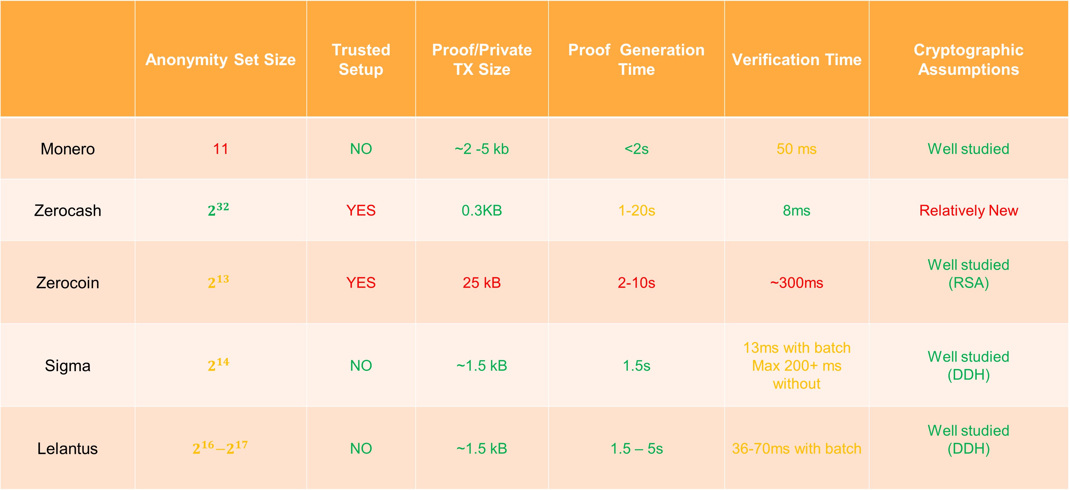
Comparison Chart
 | Anonymity Set Size | Trusted Setup | Proof/Private TX Size | Proof Generation Time | Verification Time | Cryptographic Assumptions
Monero | 11 | NO | ~2 -5 kb | <2s | 50 ms | Well studied
Zerocash | $$2^{32}$$ | YES | 0.3KB | 1-20s | 8ms | Relatively New
Zerocoin | $$2^{13}$$ | YES | 25 kB | 2-10s | ~300ms | Well studied (RSA)
Sigma | $$2^{14}$$ | NO | ~1.5 kB | 1.5s | 13ms with batch Max 200+ ms without | Well studied (DDH)
Lelantus | $${ 2}^{16}−2^{17}$$ | NO | ~1.5 kB | 1.5 – 5s | 36-70ms with batch | Well studied (DDH)

Slide 21
Finding out more
Zcoin.io
Lelantus: Private transactions with hidden origins and amounts based on DDH (lelantus.io). Paper and presentation with math details
team@zcoin.io
Welcome research and comments.
Telegram @zcoinproject
Twitter @zcoinofficial

